Slide 1

Topic: IO Devices
Lecture: Dr. Zhao Jie
Date: 04/20/2026

Slide 2
Reading Assignment
Chapters 36

Slide 3
Agenda
Combination of interface and internal
Lowering CPU overhead with interrupts
Case Study - a simple IDE disk driver

Slide 4
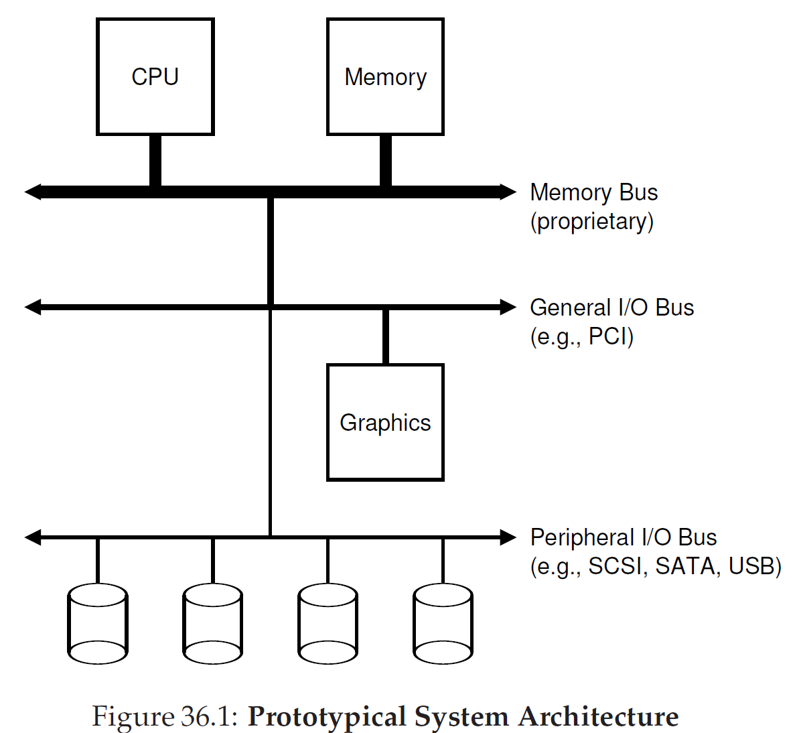
Traditional system architecture - 1
Principle
Components that demand high performance (like the graphics card) are nearer the CPU.

Slide 5
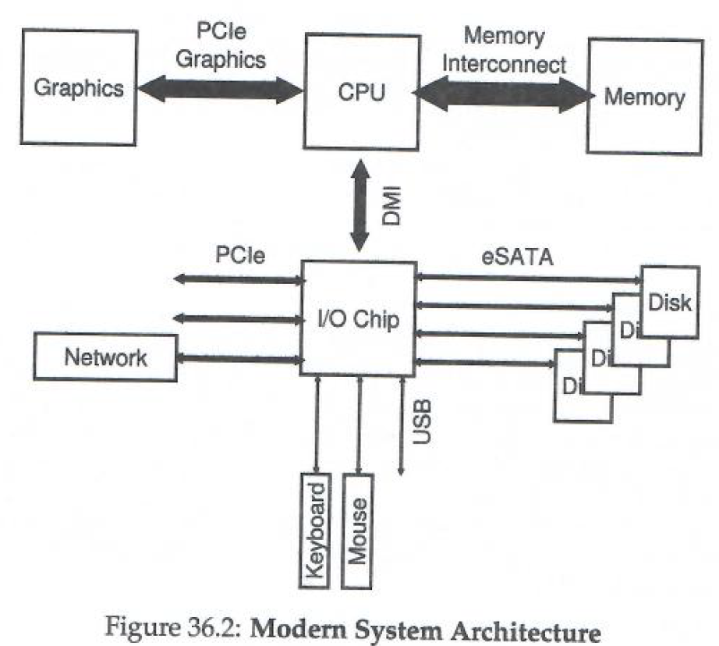
Traditional system architecture - 2
Principle
The graphics card directly communicates with the CPU. The CPU use I/O chips to communicate with other I/O devices.

Slide 6
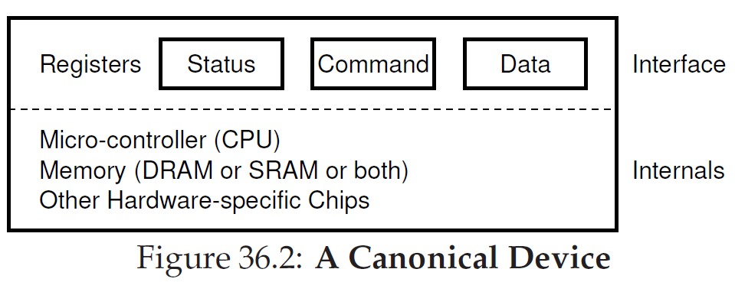
A canonical device
Combination
Interface/protocol: software, like UI, to communicate with the external.
Internal: hardware to implement functionality

Slide 7
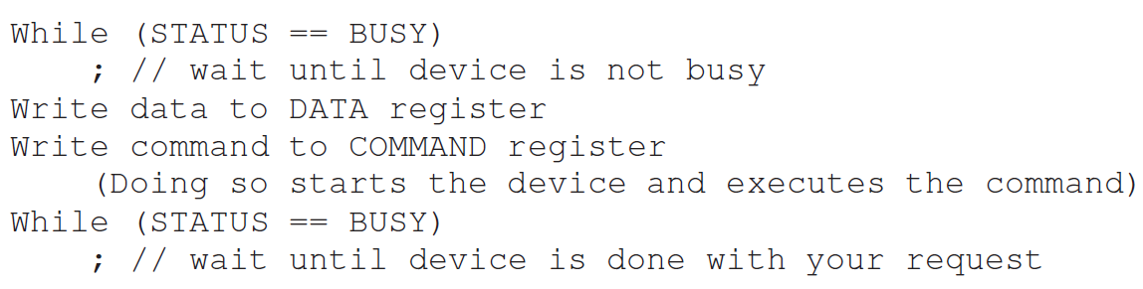
A canonical protocol
Combination
State: Register, which can be read to see the current status of the device
Data: Register to read from or write to the device
Command: Register to tell the device to perform a task
Implementation (by polling)

Slide 8
Lowering CPU overhead with interrupts - 1
Polling: Repeatedly read the state register until the device is ready to receive a command.
Implementation (by polling)
Check the device state by polling
Send the data to the data register.
Write the command to the command register.
Wait for the complement by polling.
Implementation (by interrupt)
A hardware interrupt will be raised.
The calling process will go to sleep.
The context switch works to another task.
Comparison and Contrast
Polling is inefficient. So, the interrupt is proposed.
Notes:
To understand the difference between polling and interruption, let me take an example. If stu A wants to use the study room that stu B has been using now. Polling means stu A will check the use of the study room from time to time, and the interruption means stu A will request the use of the study room, and he or she will get response when it is ready. The interruption allows stu A can do other tasks while waiting for the use of the study room and this is efficient work for stu A.

Slide 9
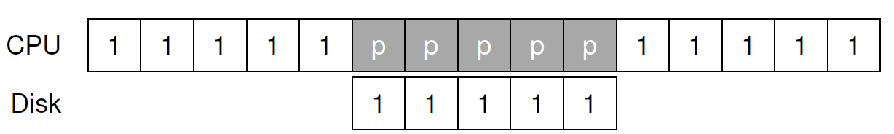
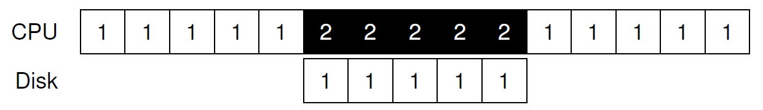
Lowering CPU overhead with interrupts - 2
Compare using polling or interrupt; which one is more efficient?
P: polling/spins
1: Process 1
2: Process 2

Slide 10
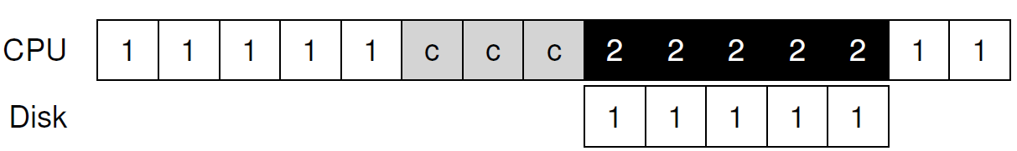
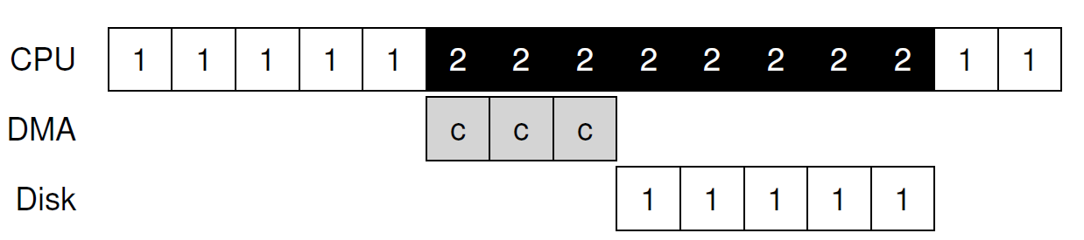
More efficient data movement with DMA
DMA (Direct Memory Access)
A device allows data to be accessed between the device and the main memory without the CPU intervention.
Compare with/without using the DMA; which one is more efficient?
C: CPU
1&2: Processes

Slide 11
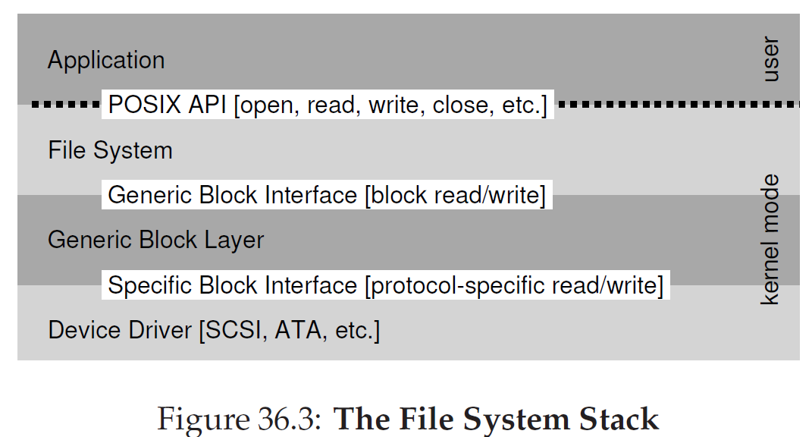
Fitting into the OS: the device driver
Device driver
OS interacts with different devices and uses a general protocol, abstraction.
The device driver, a piece of software in the OS, specifies interaction with different devices.

Slide 12
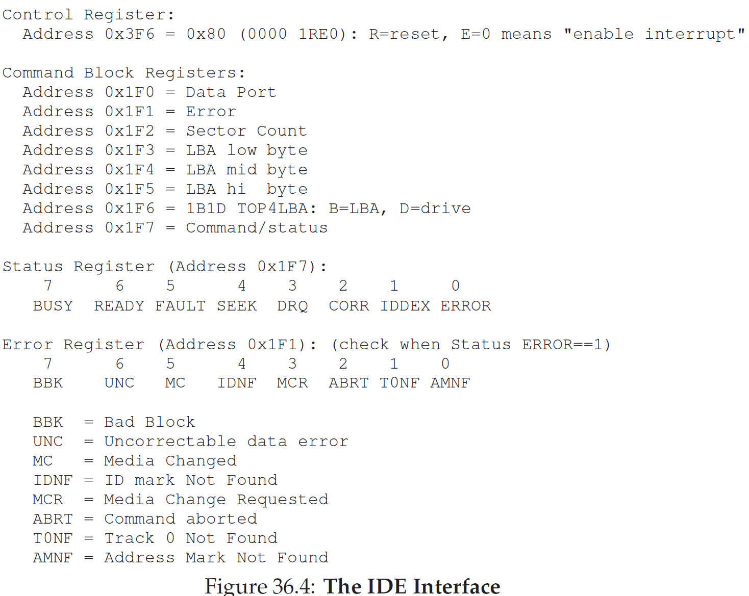
Case Study: a simple IDE disk driver -1
Example

Slide 13
Case Study: a simple IDE disk driver - 2
Implementation
Waiting for the driver to be ready. Read the Status register(0x1F7).
Write parameters to command registers, including the sector count, logical block address(LBA), and driver number.
Start the I/O. Write READ/WRITE command to command register(0x1F7)
Data transfer (for writes). Wait until the drive status is READY and DRQ(drive request data); write the data to the data port.
Handle interrupts. Remember, interrupts help boost CPU capability.
Error handling. After running, check the status register.

Slide 14
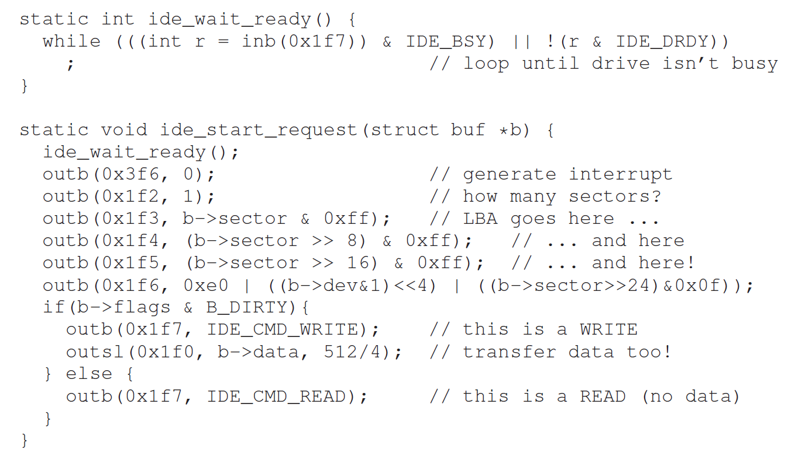
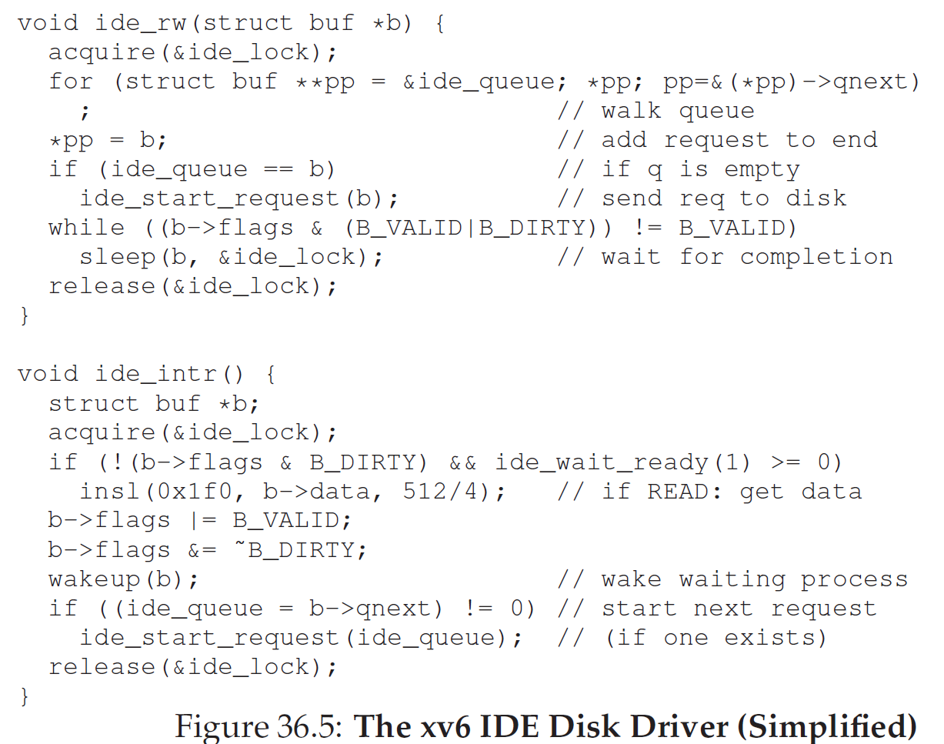
The xv6 IDE disk driver

